Slide 1
Smart Cities: Toronto & Portland
Will Regan, Long Nguyen, Kennedy Hahn

Slide 2
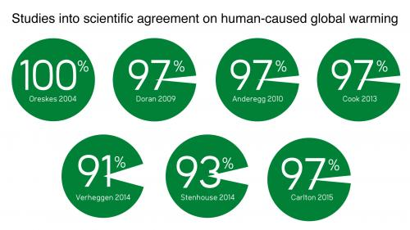
Why are we building smart cities?
One Reason
Climate Change
it’s not a hoax - skepticalscience.com

Slide 3
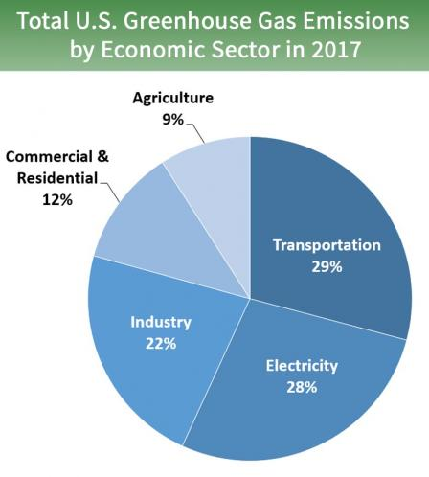
What causes climate change?
Graphic provided by epa.gov greenhouse gas emissions
Emissions only: Does not take into consideration negative feedback loops such as deforestation or decreasing ability of ocean to sequester carbon.

Slide 4
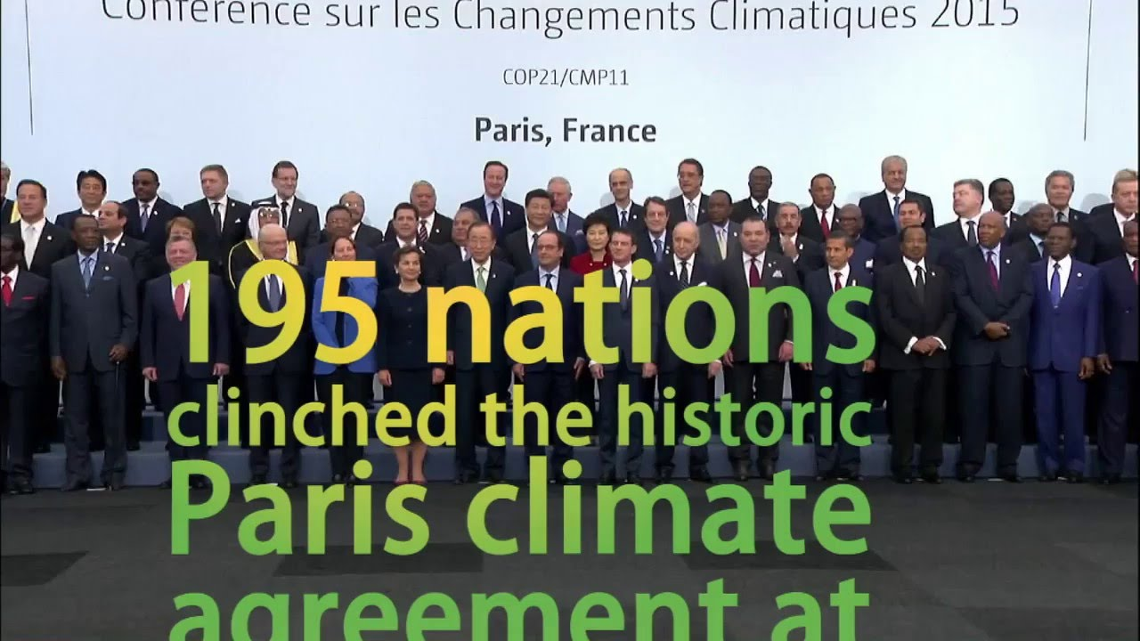
Paris Climate Agreement
What is it?
The Paris Agreement builds upon the Convention and for the first time brings all nations into a common cause to undertake ambitious efforts to combat climate change and adapt to its effects, with enhanced support to assist developing countries to do so. As such, it charts a new course in the global climate effort. - official description from carbonbrief.org

Slide 5
China
China: 23% of all emissions:
No date for carbon neutrality - wikipedia - carbon neutral
A peak in carbon dioxide emissions by 2030, with “best efforts” to peak earlier. China has also pledged to source 20% of its energy from low-carbon sources by 2030 and to cut emissions per unit of GDP by 60-65% of 2005 levels by 2030, potentially putting it on course to peak by 2027. CarbonBrief.org - climate pledge

Slide 6
United States
The US: 12% of all emissions vs 4.2% of the world’s population
No date for carbon neutrality - but several cities have pledged to become carbon neutral by 2050 - wikipedia - carbon neutrality
[The US plans to withdraw from Paris and not meet this pledge] 26-28% domestic reduction in greenhouse gases by 2025 compared to 2005, making its best effort to reach the 28% target. This includes the land sector and excludes international credits at this time. Carbon Brief has a more detailed article on the US INDC. - CarbonBrief.org climate pledges
This is all despite having access to clean energy sources and technology not available in third world countries.

Slide 7
Europe - the EU
Roughly 9% of all emissions
The European Commission calls for a climate-neutral Europe by 2050. - wikipedia - carbon neutrality
At least a 40% domestic reduction in greenhouse gases by 2030 compared to 1990 levels. Carbon Brief has a more detailed article on the EU INDC. - CarbonBrief.org climate pledges

Slide 8
Canada
2% of all emissions vs .05% of the world’s population
No estimate for carbon neutrality - wikipedia - carbon neutrality.
A 30% reduction on 2005 greenhouse gas emissions, by 2030. This includes possible use of international emissions credits. It also includes the land sector and forestry. - CarbonBrief.org climage pledges

Slide 9
Threat of Direct Action
Extinction Rebellion
Global movement 722 localities in 15 countries
Attempting to influence policy through direct action and civil disobedience
Government must act now to halt biodiversity loss and reduce greenhouse gas emissions to net zero by 2025 (average goal is 2050).
Threats of increasingly disruptive climate actions
Calling for divestment in major financial institutions, especially carbon based.

Slide 10
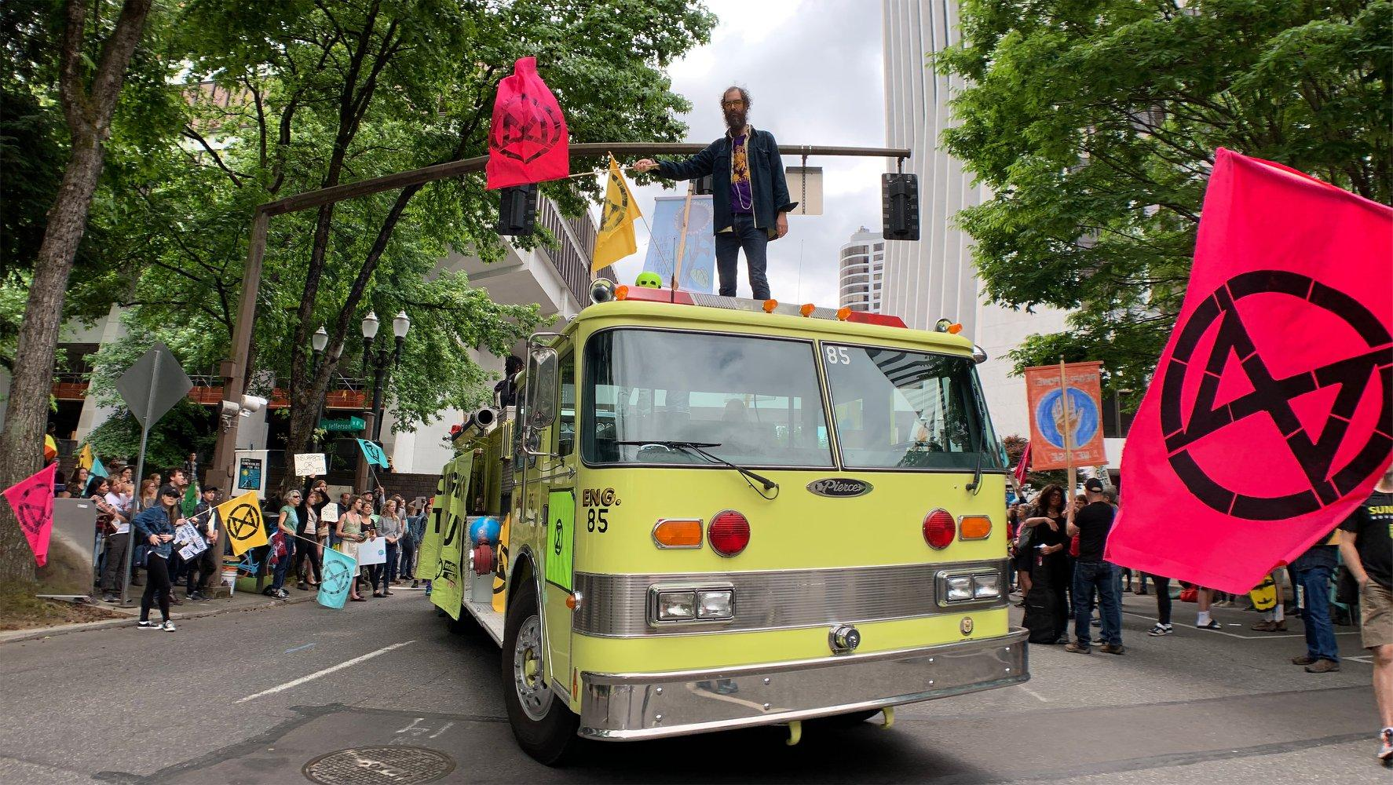
Portland - 80% reduction in emissions by 2050
Ranked 52 for high ozone days out of 228 metropolitan areas
Ranked 23 for 24-hour particle pollution out of 217 metropolitan areas
Ranked 149 for annual particle pollution out of 203 metropolitan areas
Via American Lung Association - Portland-Vancouver-Salem, OR-WA
Image from Extinction Rebelion Portland, across from Portland City Hall, June 22nd, 2019

Slide 11
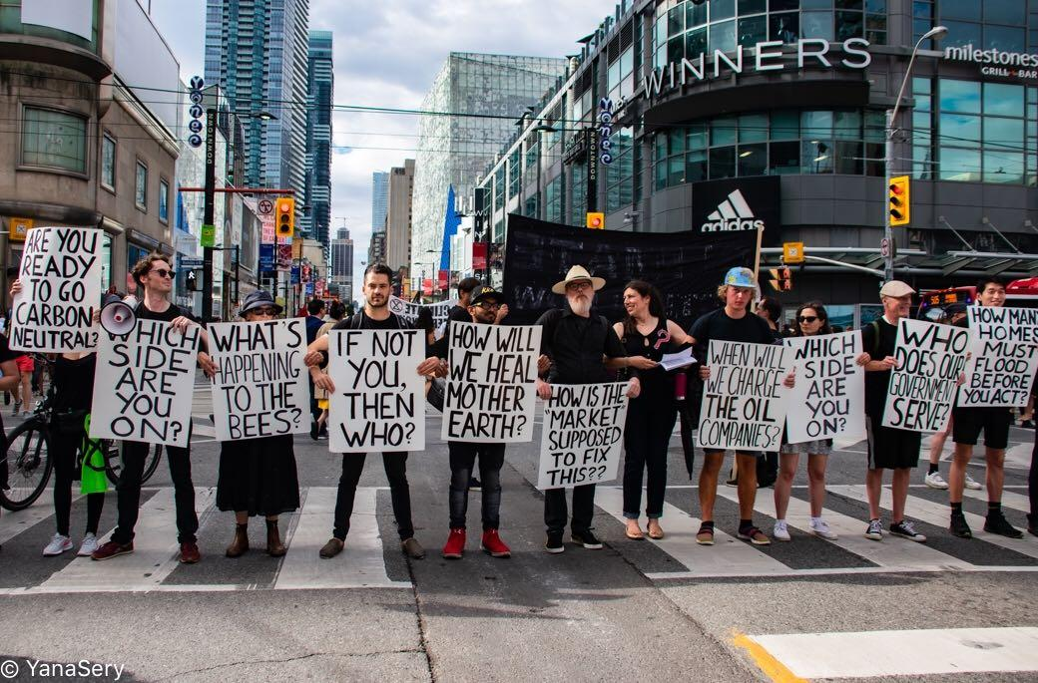
Toronto - 80% reduction in emissions by 2050
Extinction Rebellion Toronto

Slide 12
Some actions to take
Survey surrounding areas for solar or wind, or offshore wind, using coast (80 miles west of Portland) or desert (220 miles east).
Explore options of taxing carbon and gas within city limits, and partner with neighboring cities to do the same. Taxing Uber during peak hour operations.
Electric Buses
Survey parking structures for retrofitting solar energy panels.
No new fossil fuel infrastructure, such as Zenith Tar Sands

Slide 13
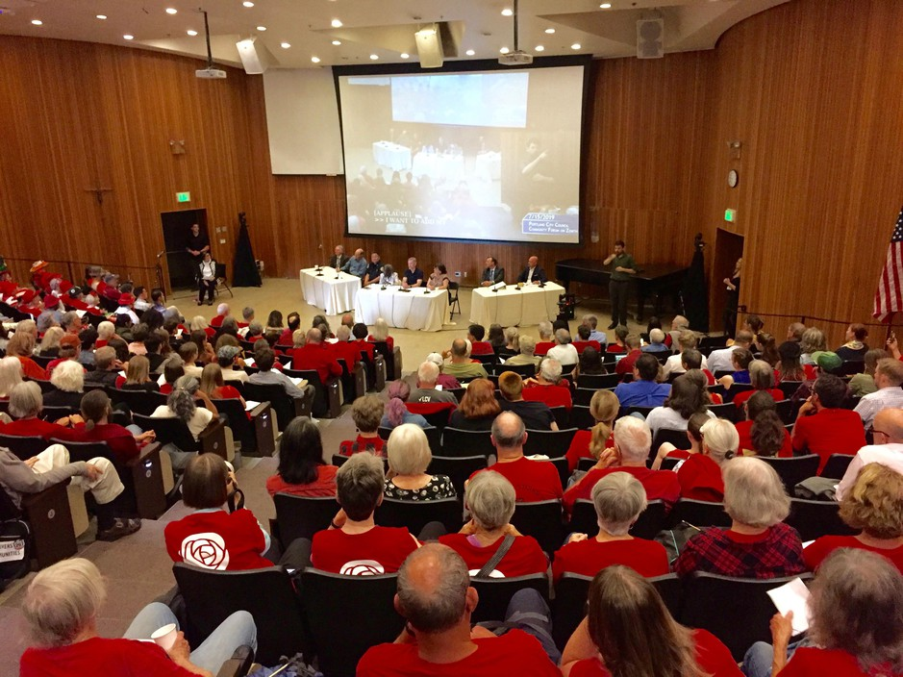
Hundreds Convene In Portland To Block Zenith Oil Terminal Plans
Imagine a city that allows citizens to engage
and make decisions on this without having to physically show up to city council meetings which can be costly and inefficient.
400 attended, People who opposed expansion were told to wear red

Slide 14
Other reasons for smarter cities
City Beautification
Accessibility
Population
Homelessness
Safety

Slide 15
Toronto

Slide 16
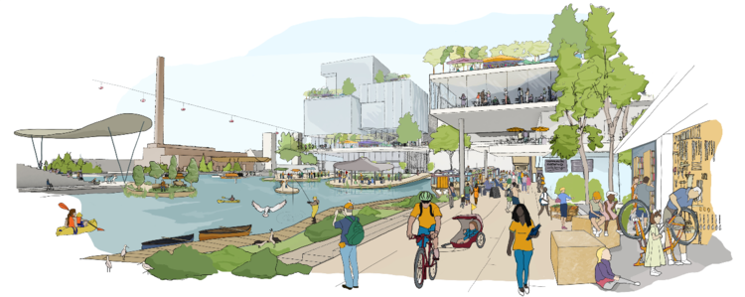
What is Sidewalk Toronto?
“...a [12-acre] thriving hub for innovation...”
Image from BusinessInsider
Notes:
Google company coming in to make city smart
Even the transportation plans reflect reasons for building smart city

Slide 17

Increase public transit use
Using real-time transit data could increase public transit use
“...a future where integrated real-time data from transportation options enable a true mobility system that rivals private car use on convenience” (Jaffe 2018).
Image from “A vision of city transportation, circa 2043”
Notes:
Ties in to accessibility reason for making a smart city

Slide 18
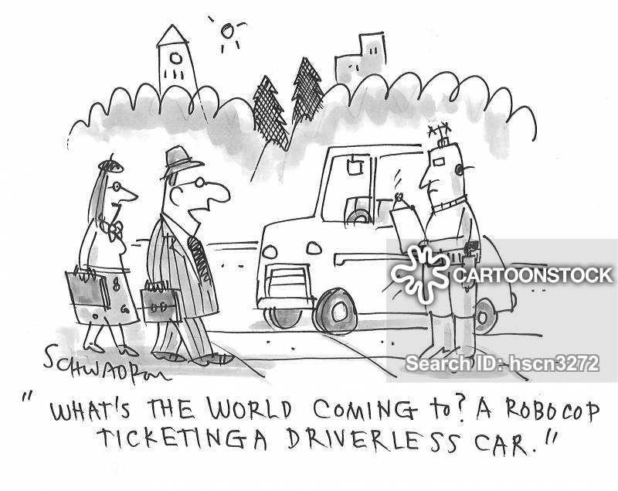
Decreasing the number of private vehicles
Parking and Curbside Availability
Tracking blocks for curbside and/or street parking
Increasing cost to park/parking tickets
Using a real-time map of road pricing
Charging mileage depending on time of day
Charging by route

Slide 19
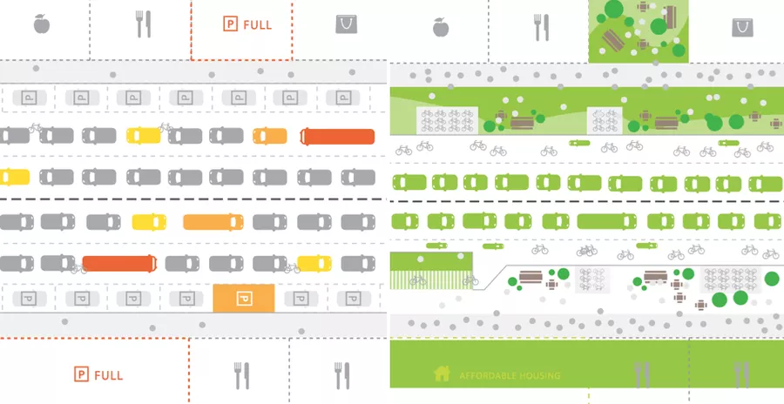
Decreasing the number of private vehicles - benefits
Reducing vehicles on the road and required street parking can create more room for reclaimed parks and housing.
Notes:
Ties into homelessness reason for smart city

Slide 20
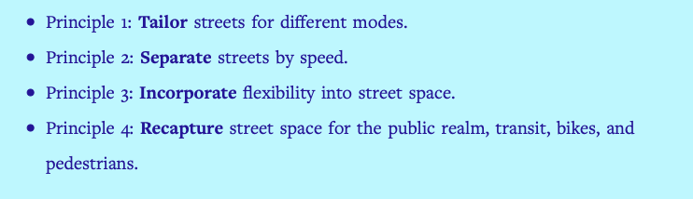
Increasing Safety
Sidewalk Labs’ principles for building streets in smart cities:
Image from “Four principles for the future of city streets”
Notes:
Ties into safety reason for smart city

Slide 21
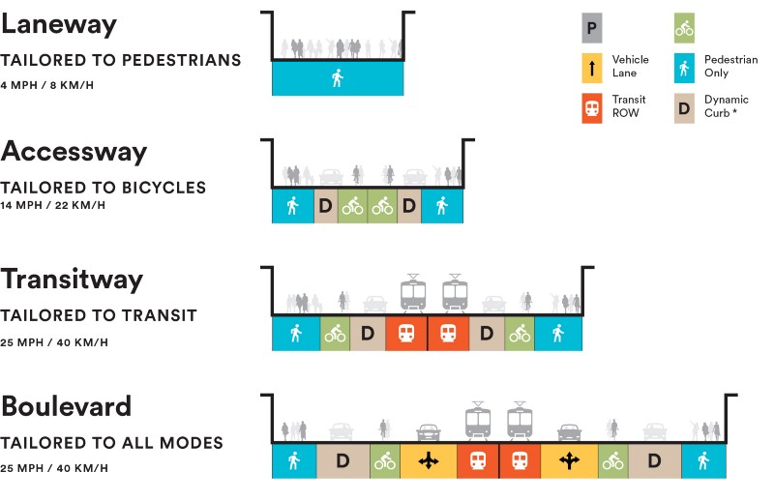
Increasing Safety
Image from “Four principles for the future of city streets”

Slide 22

Promoting Cycling and Walking
Heated, light-up bike lanes
“Building raincoats”

Slide 23

Concerns & Controversy
Data harvesting
From “Smart City of Privacy” to “Smart City of Surveillance” (The Guardian)
Third parties are able to access personal information gathered in the city
Sidewalk Toronto fails to be transparent
Image from The Intercept

Slide 24
Portland
Notes:
Long’s

Slide 25
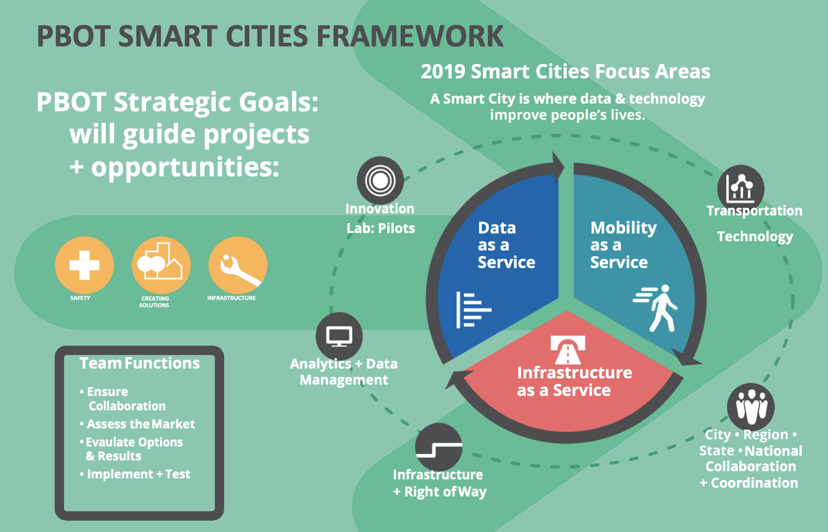
Portland Smart City Initiatives
Biketown
Parking Kitty
E-Scooters
Traffic Safety Sensor Project
Portland Urban Data Lake

Slide 26
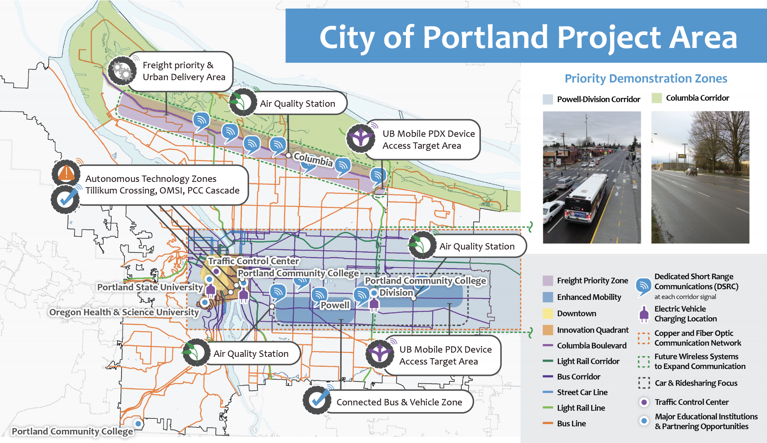
Portland Smart City Initiatives
Notes:
Long’s

Slide 27
Ubiquitous Mobile PDX Framework
In Portland’s Smart City: The Internet of Things will be used to collect information and intelligent systems will analyze the information to optimize operations.
Notes:
Long’s

Slide 28
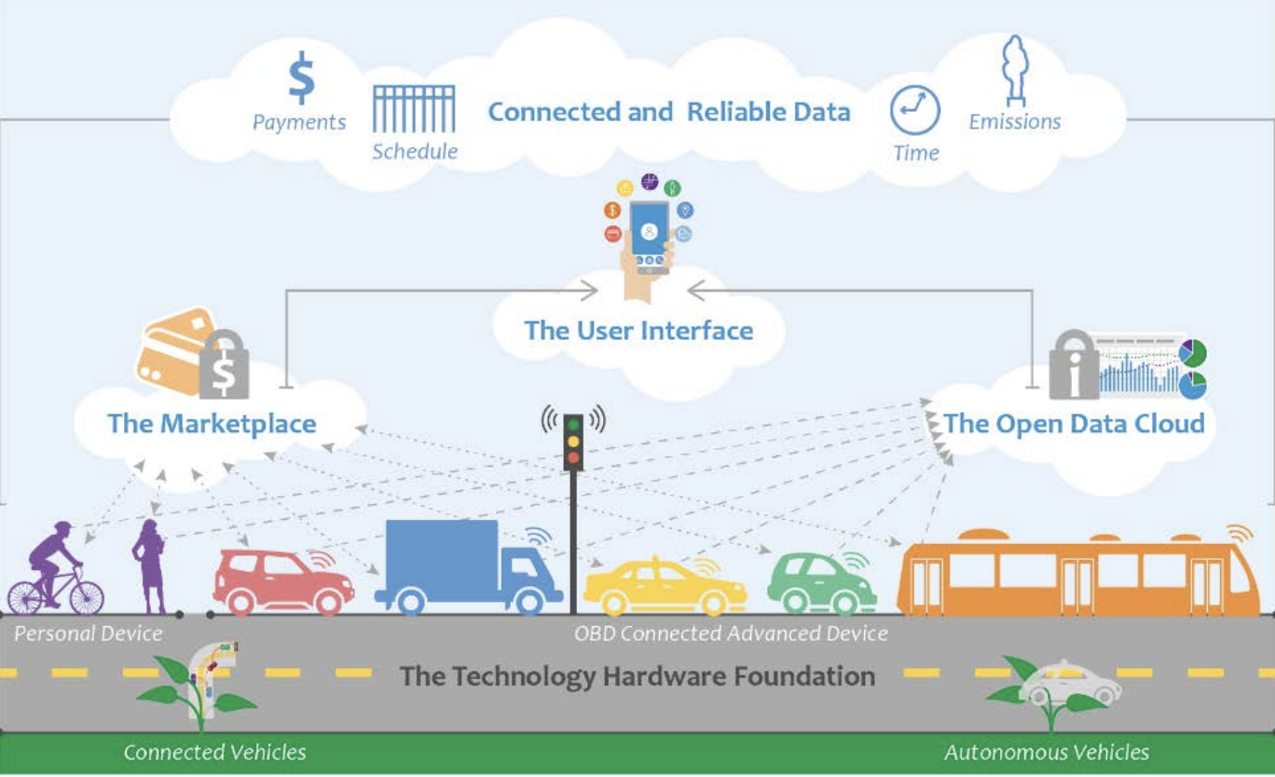
Ubiquitous Mobile PDX Framework
Notes:
Long’s

Slide 29
Portland Cycling and Walking
Cycling
Oregon ranked 5th in Bicycle Friendly State Ranking in USA, 2017
Walkability
Portland ranked 7th in nation’s most walkable cities
Notes:
Long’s

Slide 30
Shared E-Scooters
To improve city mobility services, Portland will require e-scooter firms to provide detailed trip locations and other level of data granularity to help drive it’s smart city initiative
The data will show how many e-scooter trips were taken, the start and end, and other information to track use and impact. This helps integrate the e-scooters into the transportation apps such as Trimet’s Trip Planner.
Portland By Scooter (helpful map for scooter riders)
Notes:
Talking points:
LA Mobility Data Specification
Need Pictures

Slide 31

Shared E-Scooters
Concerns: being left everywhere, safety concerns for riders

Slide 32
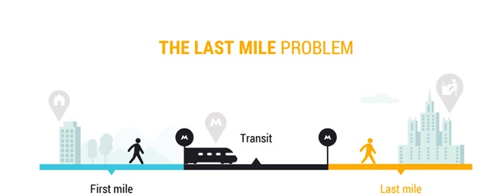
Last-Mile Transportation
The problem: public transportation doesn’t take us exactly where we need to go.

Slide 33
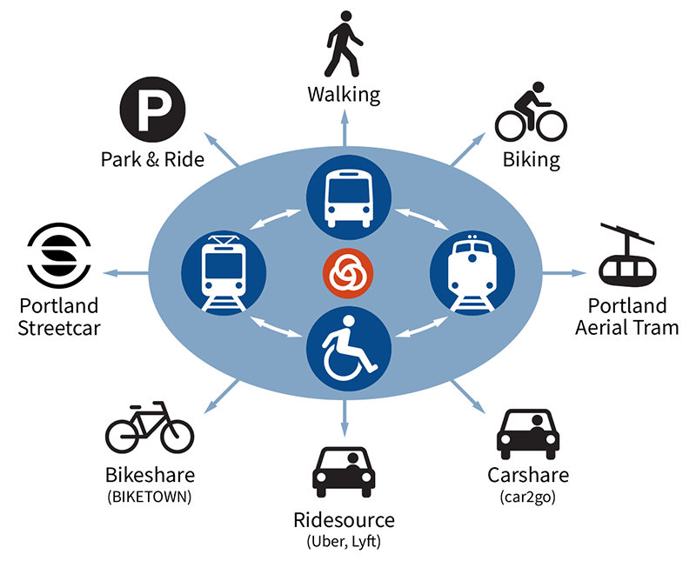
Mobility On Demand (MOD)
The first US transit agency to release a multimodal trip planner that incorporates different type of mobility providers like uber, zipcar, biketown, car2go, and trimet public transit.
This is created by using open source technology and open data, which benefits other agencies to include the technology into their own transit applications.

Slide 34
Conclusion
Why are we building smart cities?
Sidewalk Toronto’s Plans for Transportation
Portland Transportation

Slide 35
Discussion, Questions, or Comments?
Some prompts:
Do the benefits of building a smart city outweigh data concerns? What are some solutions to treat these concerns?
Are smart cities aggravating data privacy issues?
Is it possible for all major cities to be smart cities? What factors would need to be addressed in order for this to happen?
How do we educate people about smart cities (benefits, disadvantages, etc.)?

Slide 36
Thank you

Slide 37
Sources - Why are we building smart cities?
Linked on slides!

Slide 38
Sources - Toronto
Anuj Prasad. 2019. Smart Mobility for Smart Cities. Entrepreneur. https://www.entrepreneur.com/article/332325
Ava Kofman. 2018. Google’s “Smart city of surveillance” faces new resistance in Toronto. The Intercept. https://theintercept.com/2018/11/13/google-quayside-toronto-smart-city
Eric Jaffe. 2018. A vision of city transportation cira 2043. Sidewalk Labs. https://sidewalklabs.com/blog/a-vision-of-city-transportation-circa-2043/
Gabriel Canon. 2018. ‘City of surveillance’: privacy expert quits Toronto’s smart-city project. The Guardian. https://www.theguardian.com/world/2018/oct/23/toronto-smart-city-surveillance-ann-cavoukian-resigns-privacy
Leanna Garfield. 2018. Google’s parent company just reached an agreement with Toronto to plan a $50 million high-tech neighborhood. Business Insider. https://www.businessinsider.com/google-sidewalk-labs-toronto-neighborhood-2018-7/
Leyland Cecco. 2019. ‘Surveillance capitalism’: critic urges Toronto to abandon smart city project. The Guardian. https://www.theguardian.com/cities/2019/jun/06/toronto-smart-city-google-project-privacy-concerns
Tech Team. 2019. Sidewalk Labs shows off light-up pavement, building raincoats, and more for its Toronto smart city project. KBC. https://www.kbcchannel.tv/tech/sidewalk-labs-shows-off-light-up-pavement-building-raincoats-and-more-for-its-toronto-smart-city-project/
Willa Ng. 2019. Four principles for the future of city streets. Sidewalk Labs. https://sidewalklabs.com/blog/four-principles-for-the-future-of-city-streets/

Slide 39
Sources - Portland
News Partner, 2019. BIKETOWN Expands Coverage, Lower Prices https://patch.com/oregon/portland/biketown-expands-coverage-lowers-prices
https://www.transit.dot.gov/research-innovation/mobility-demand-mod-sandbox-program
https://www.portlandoregon.gov/transportation/77294
Powell Meerah. 2019. E-Scooters Return To Portland. https://www.opb.org/news/article/electric-scooters-return-to-portland/

